Slide 1
J&J University’s Course Registration Module
Julian Silvestre CST499 Capstone for Computer Software Technology University of Arizona Global Campus Dr. Charmelia Butler September 3, 2025

Slide 2
Objectives
Define the requirements of the system
Develop a design plan
Implement the system
Test the system for compliance

Slide 3
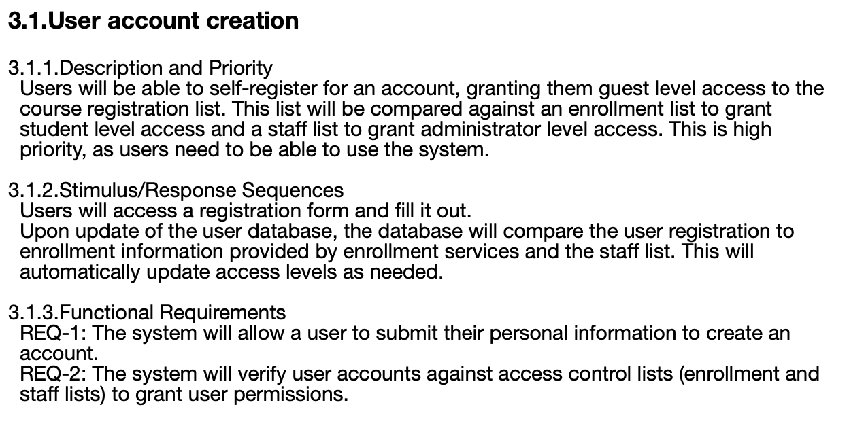
Requirements

Slide 4
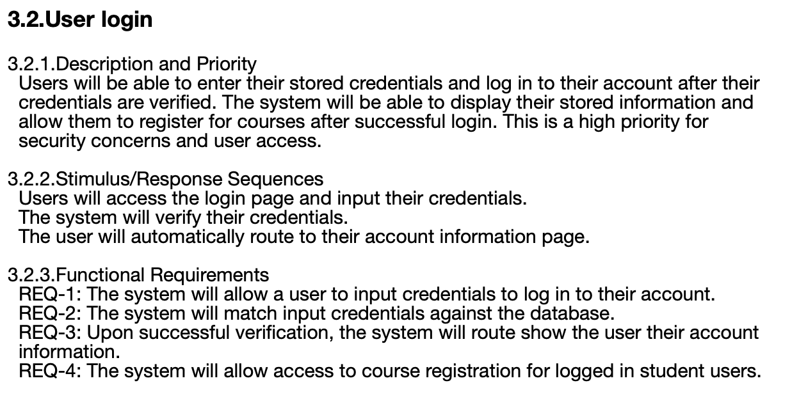
Requirements

Slide 5
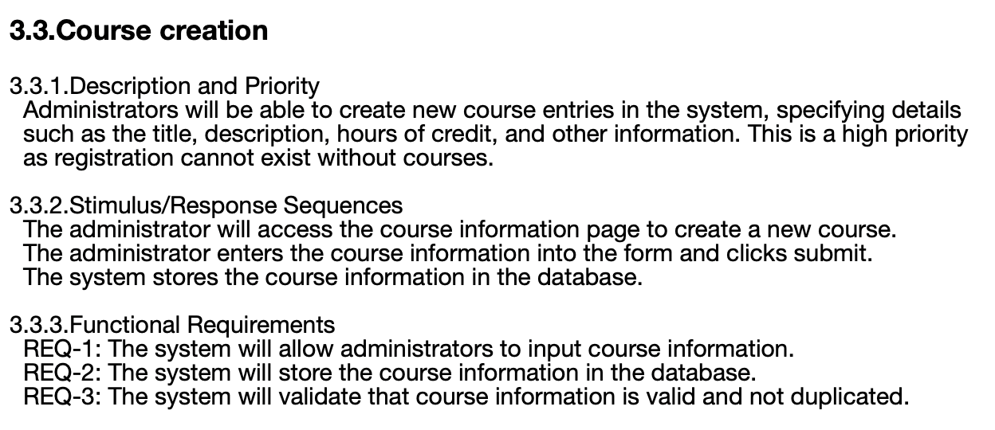
Requirements

Slide 6
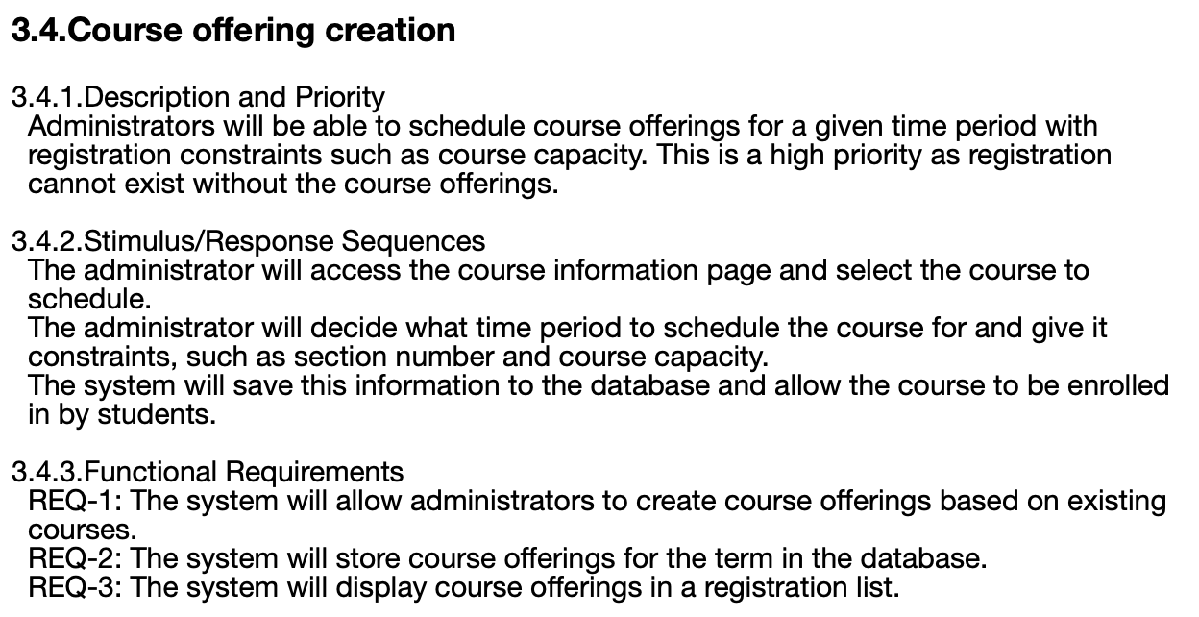
Requirements

Slide 7
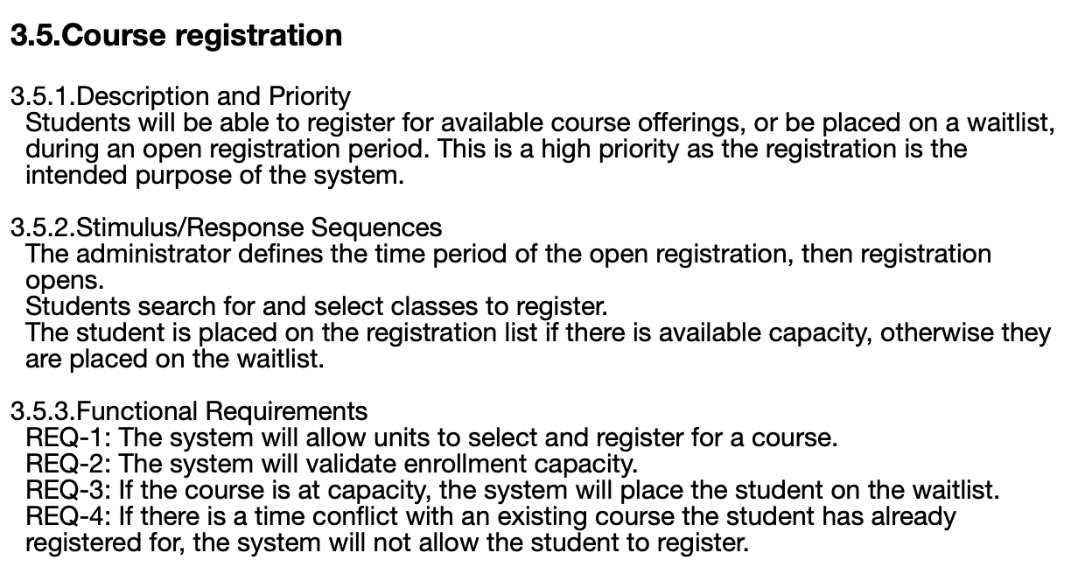
Requirements

Slide 8
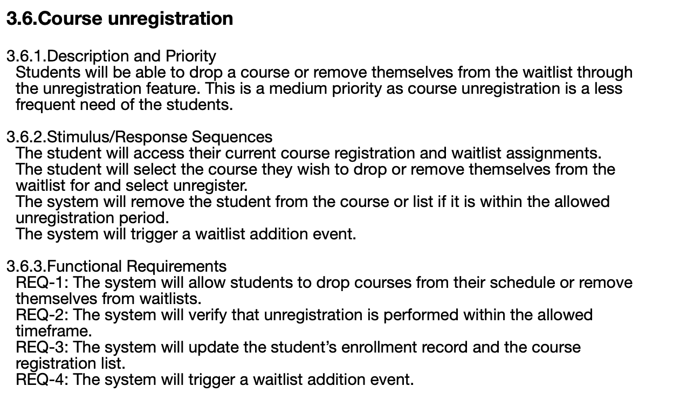
Requirements

Slide 9
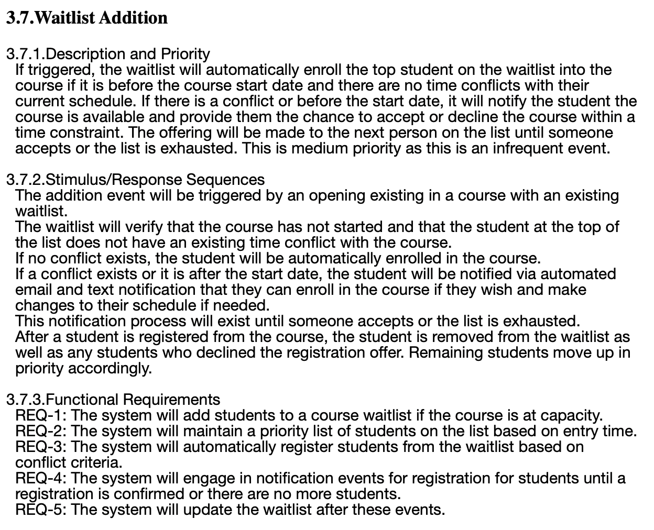
Requirements

Slide 10
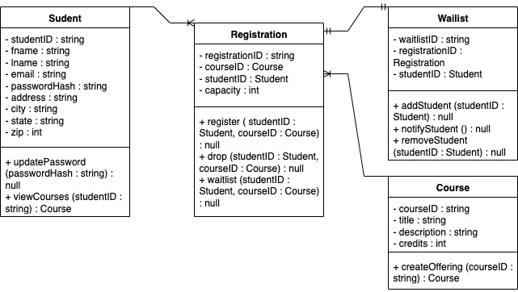
UML Design
Class Diagram

Slide 11
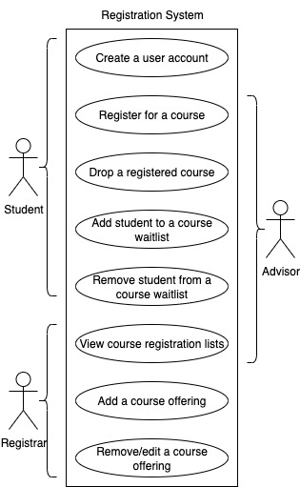
UML Design
Use Case Diagram

Slide 12
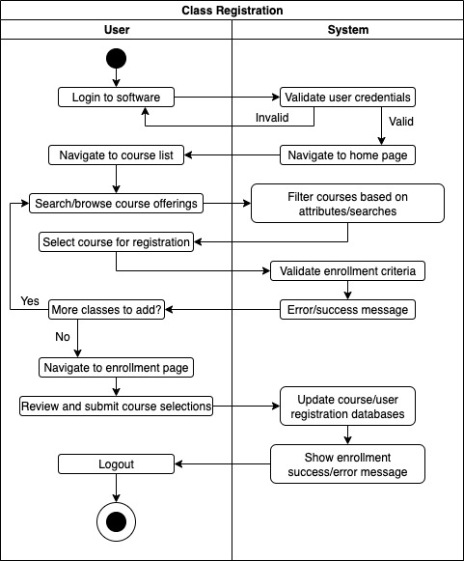
UML Design
Activity Diagram

Slide 13
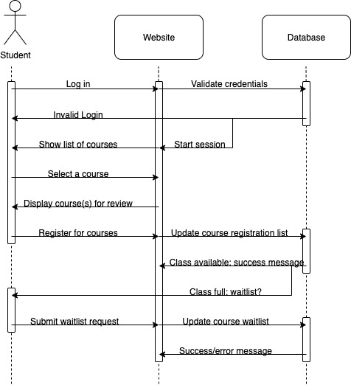
UML Design
Sequence Diagram

Slide 14
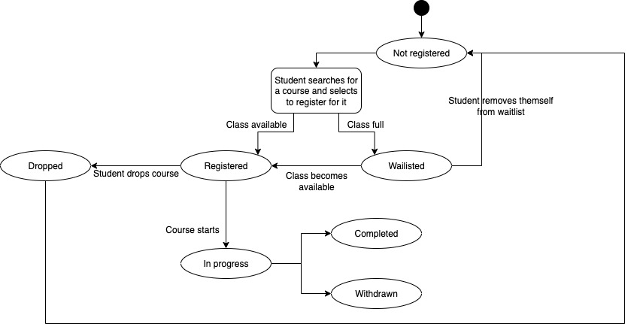
UML Design
State Diagram

Slide 15
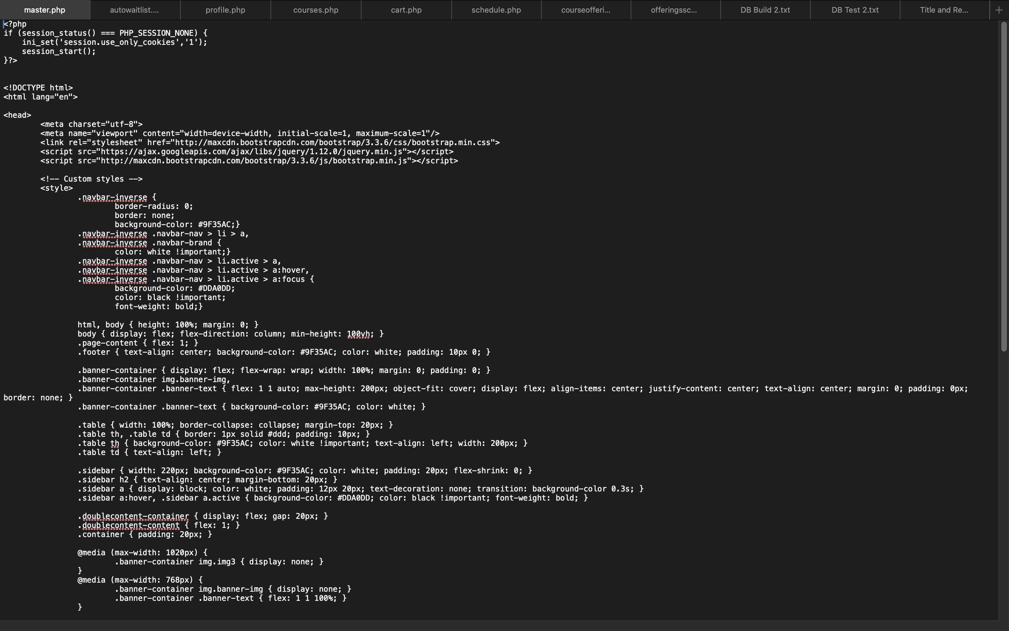
Code Files
Master File

Slide 16
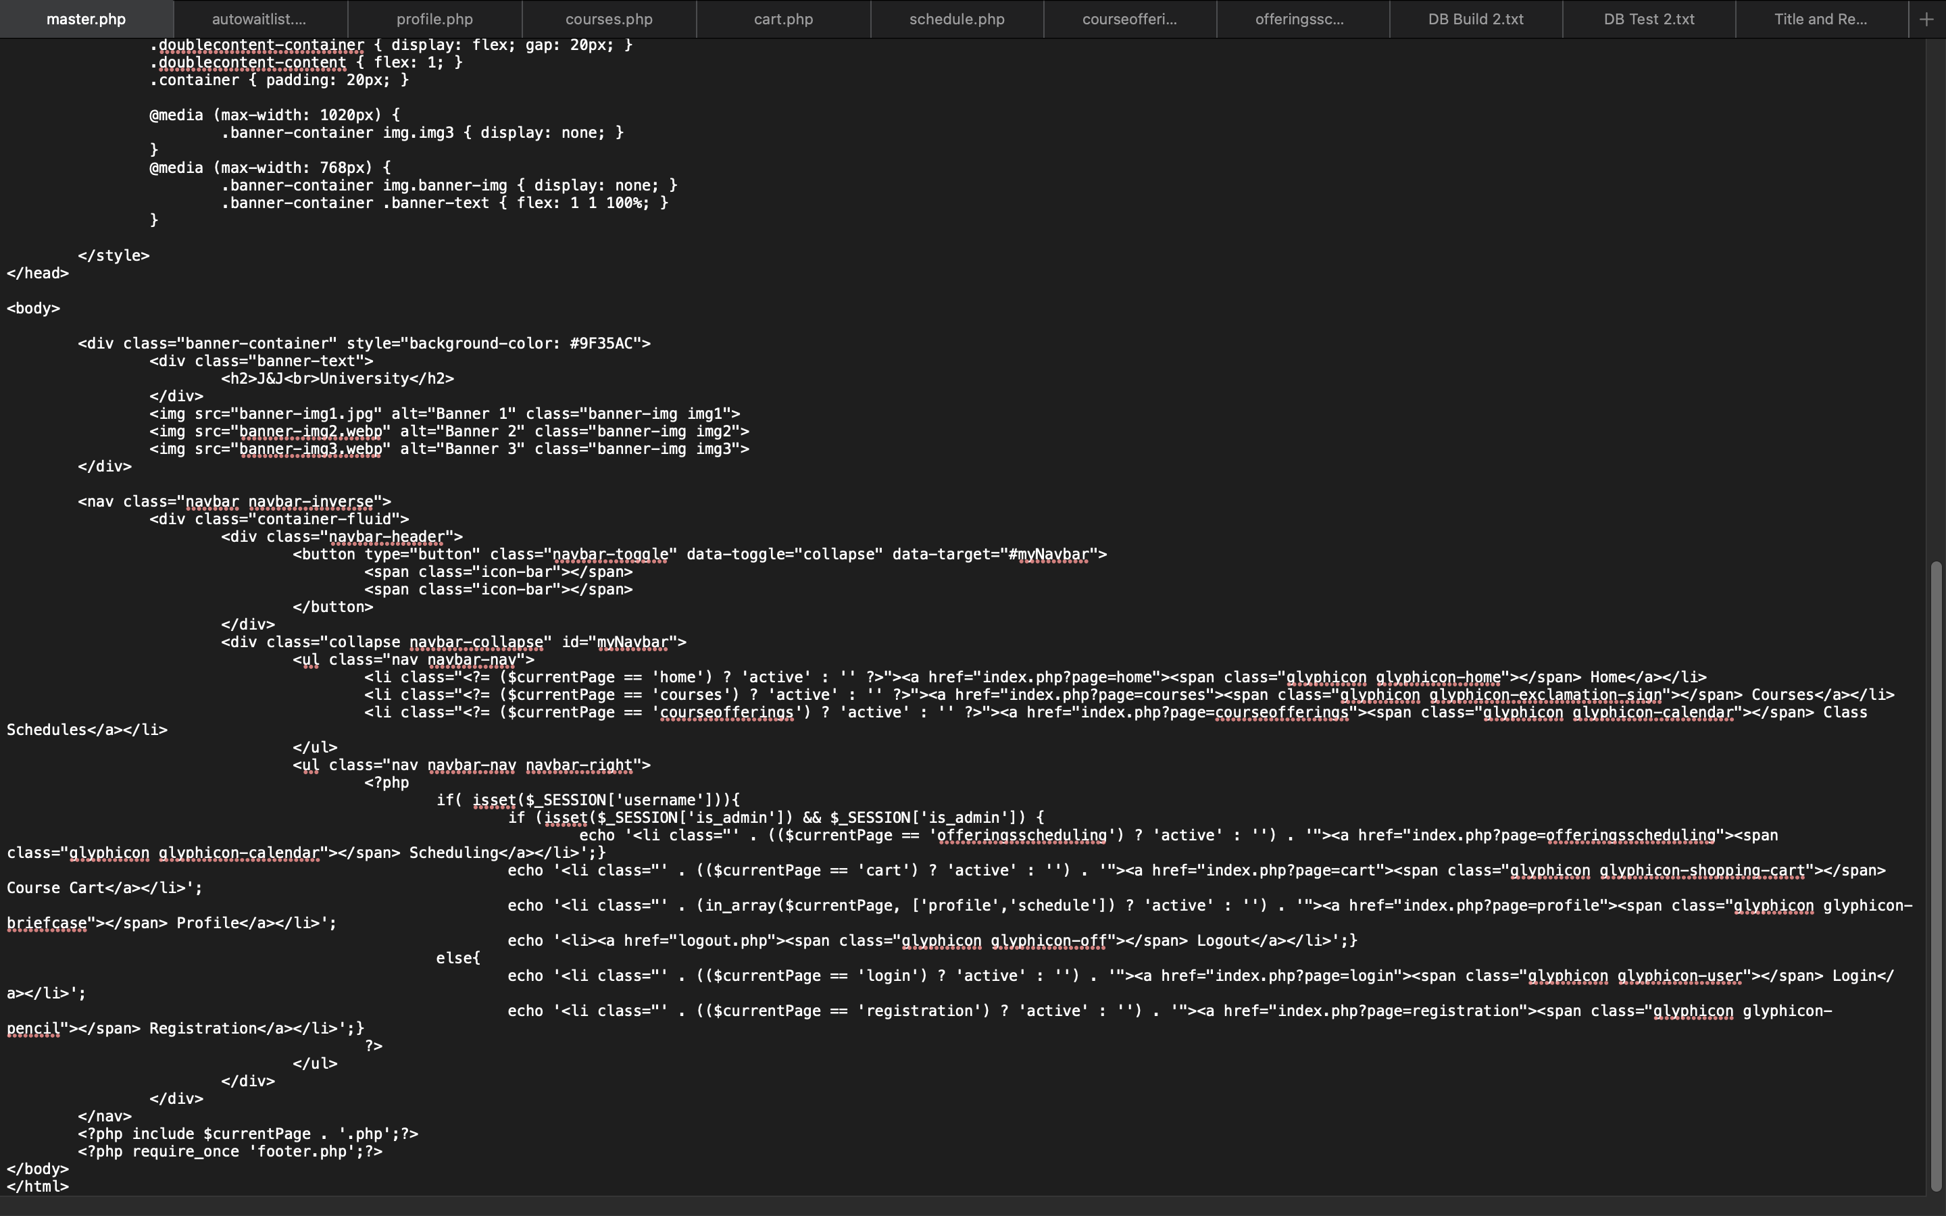
Code Files
Master File

Slide 17
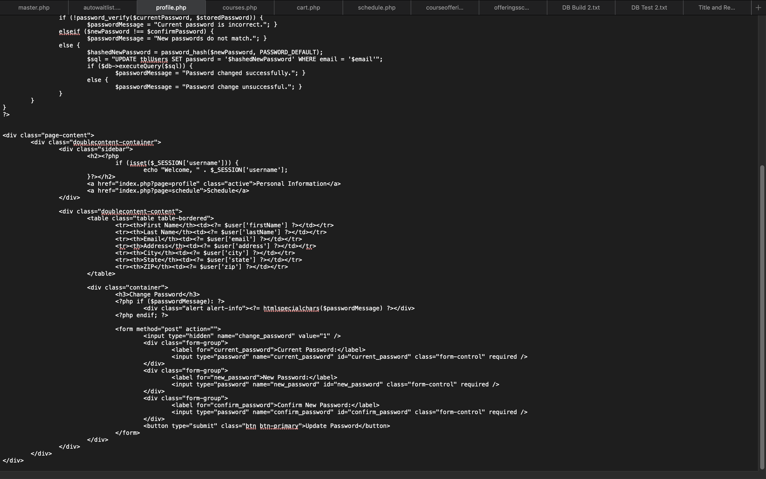
Code Files

Slide 18
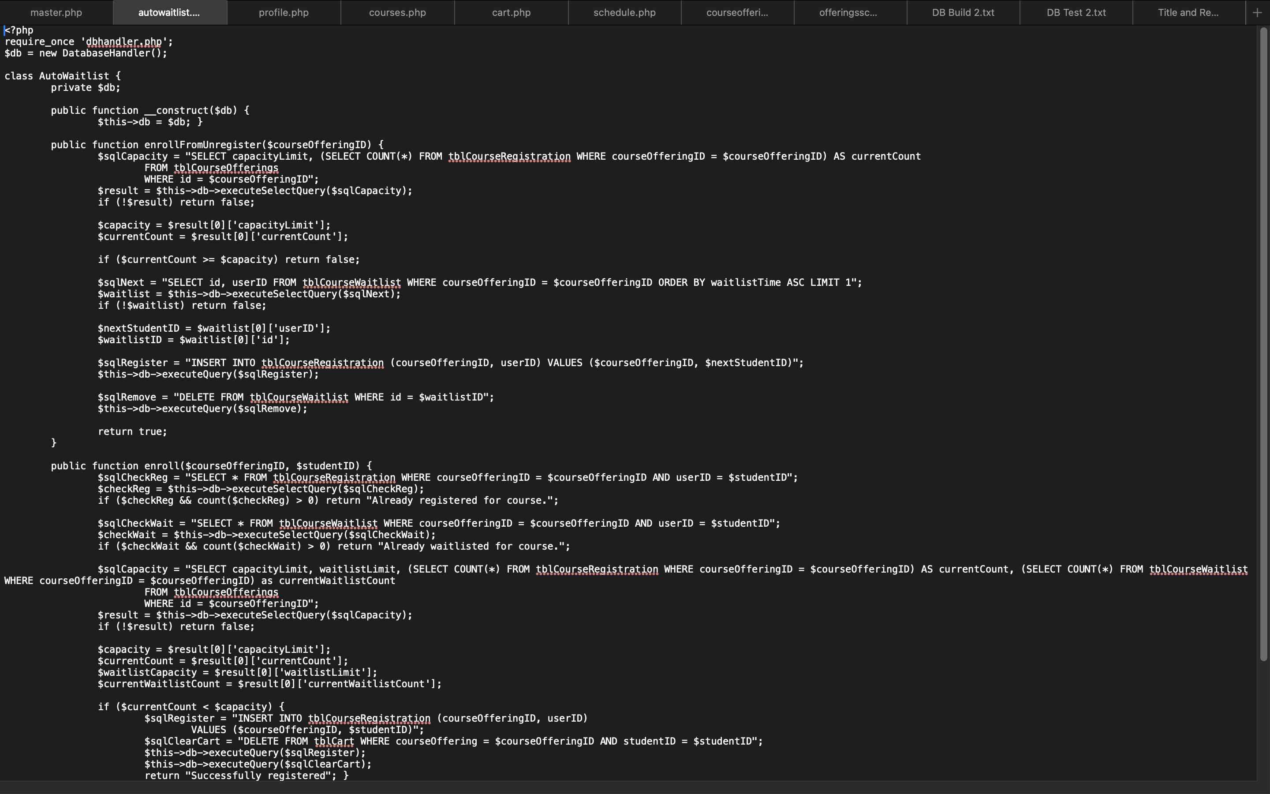
Code Files

Slide 19
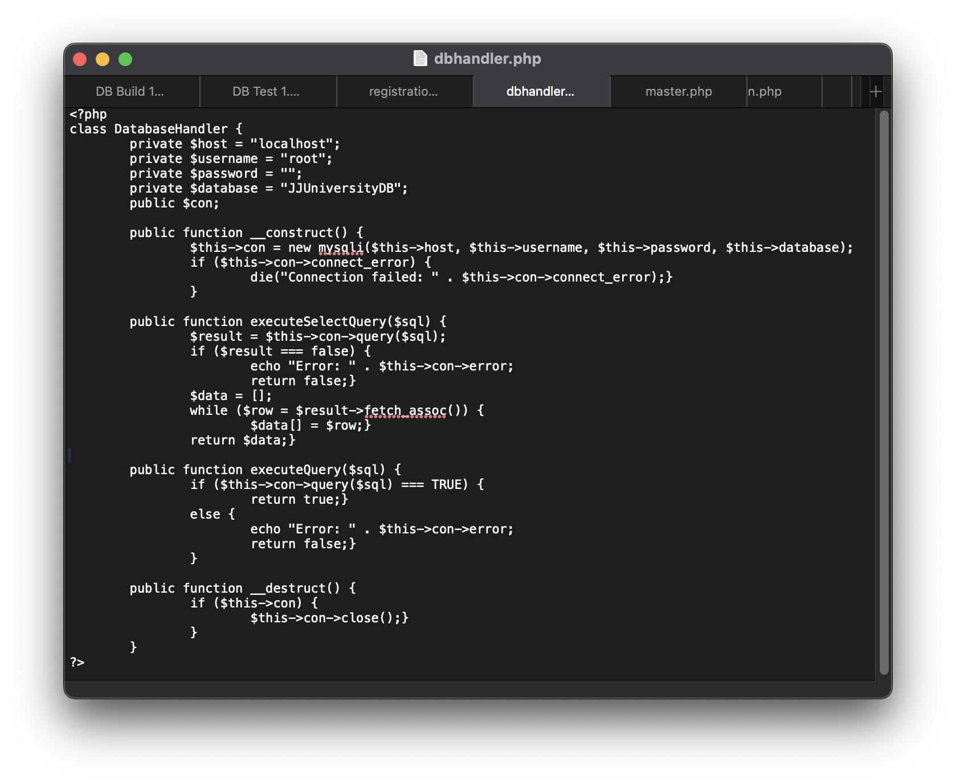
Code Files

Slide 20
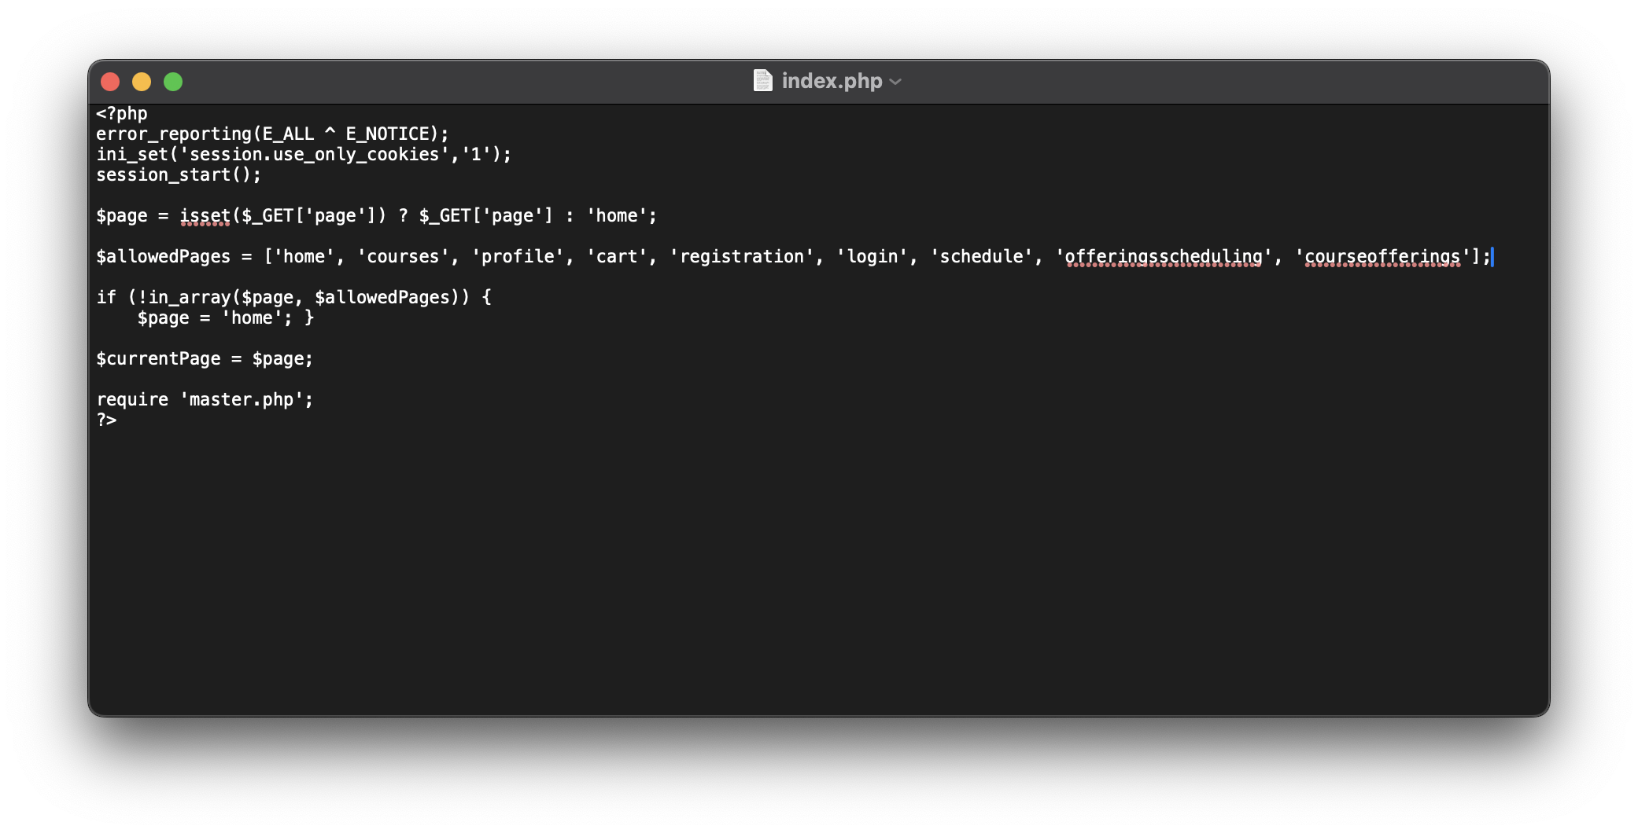
Code Files

Slide 21
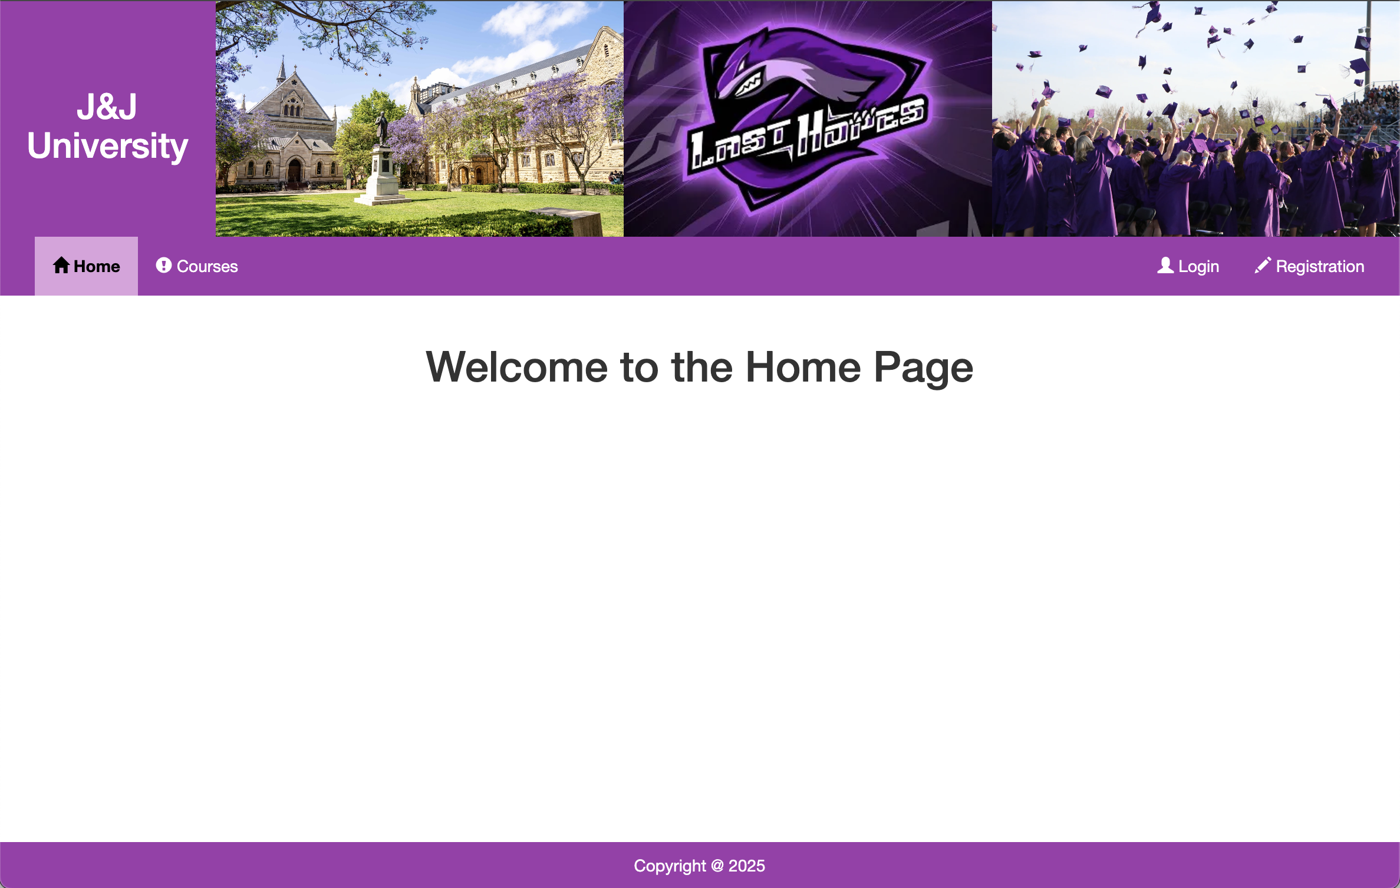
Visual Design
Home Page

Slide 22
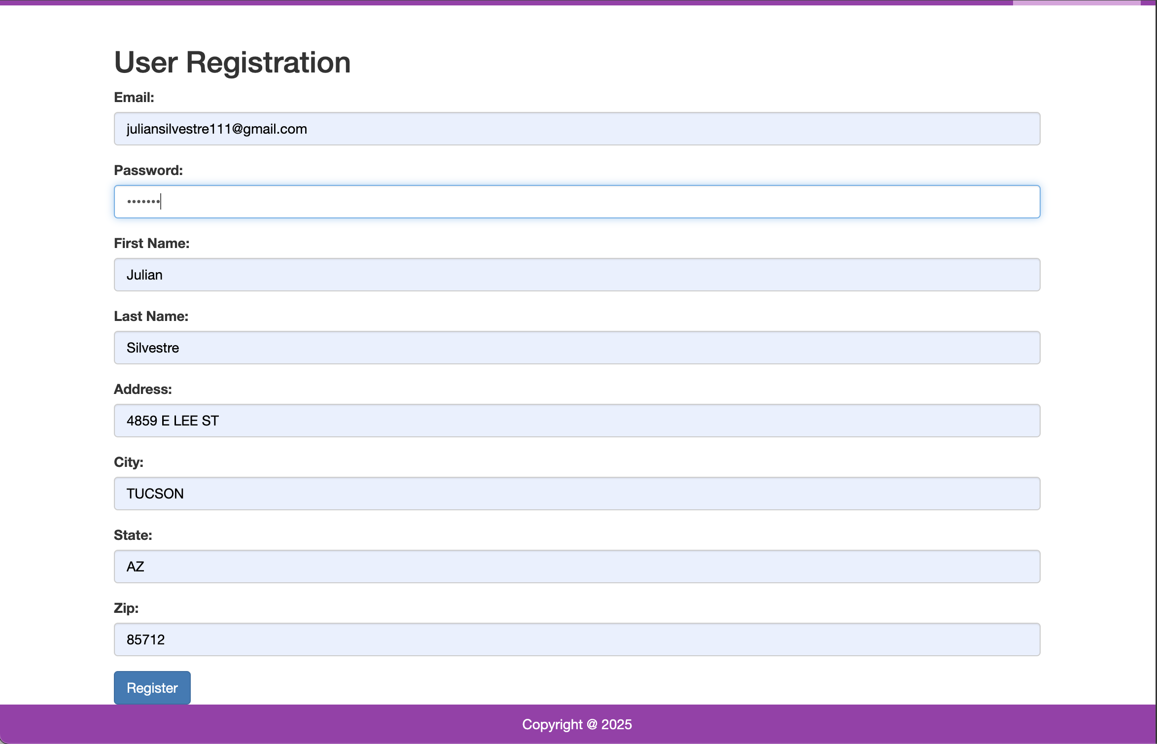
Visual Design
User Registration

Slide 23
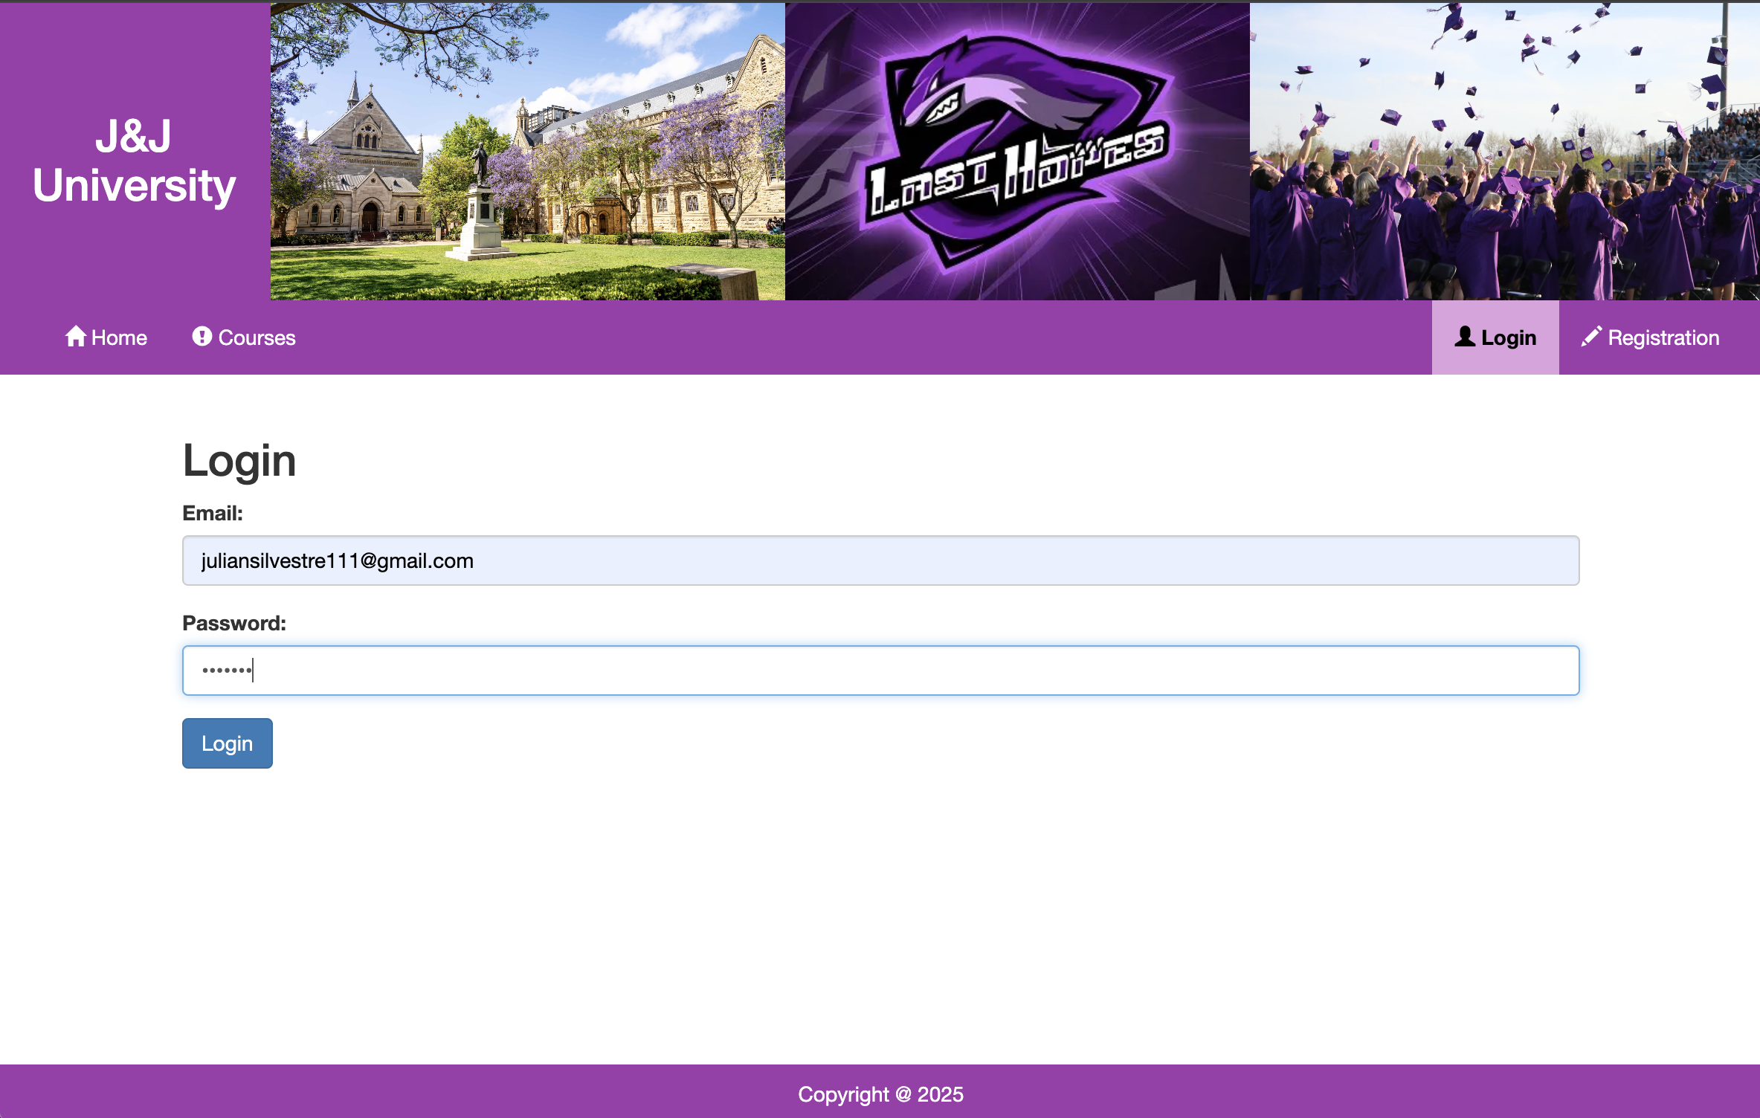
Visual Design
Login Page

Slide 24
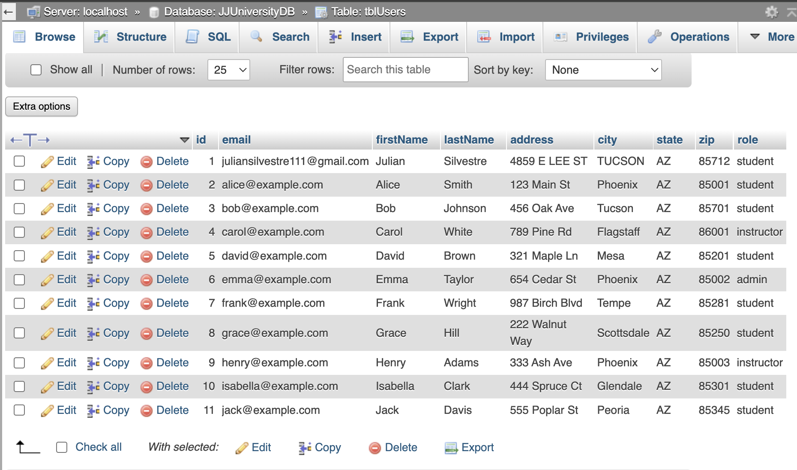
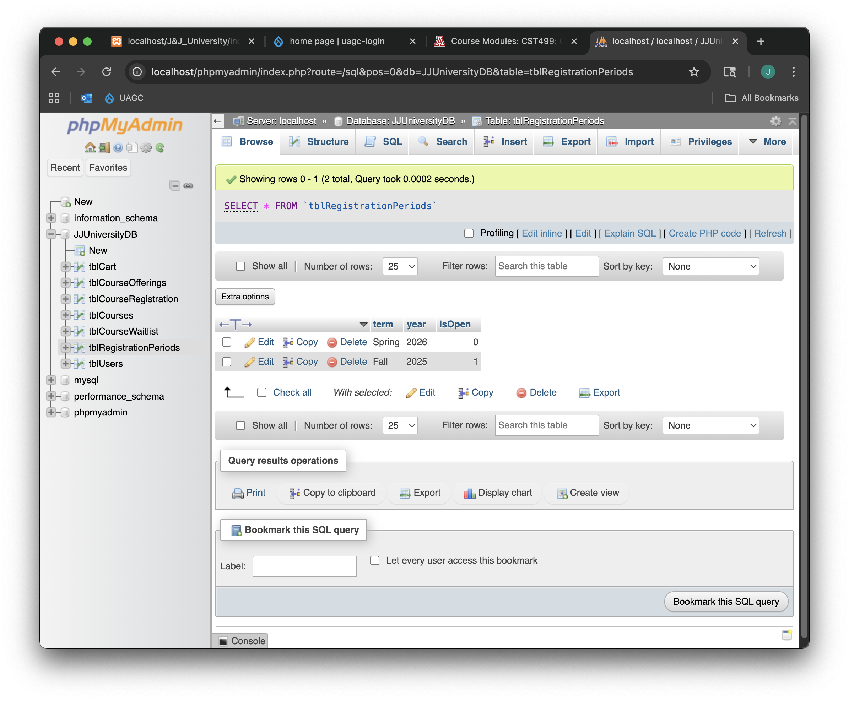
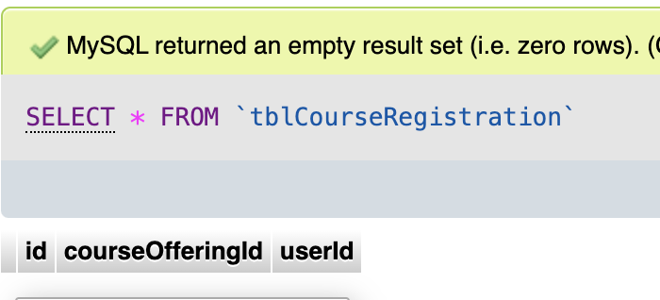
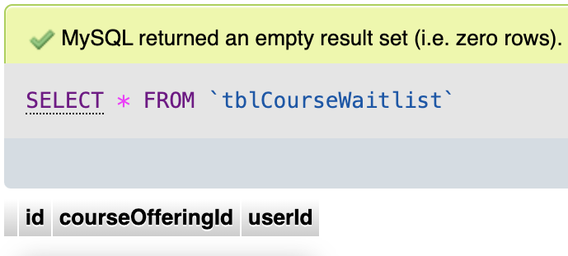
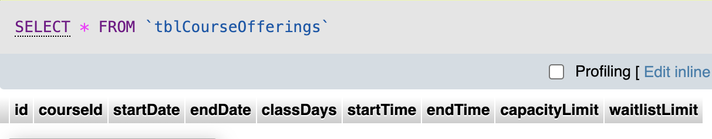
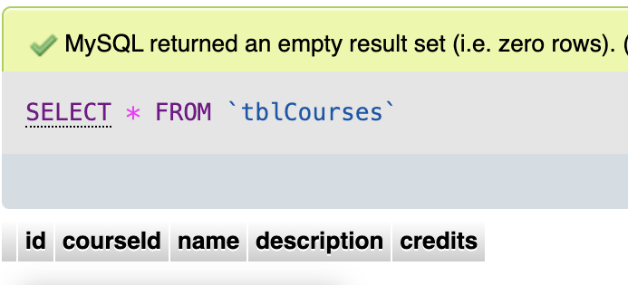
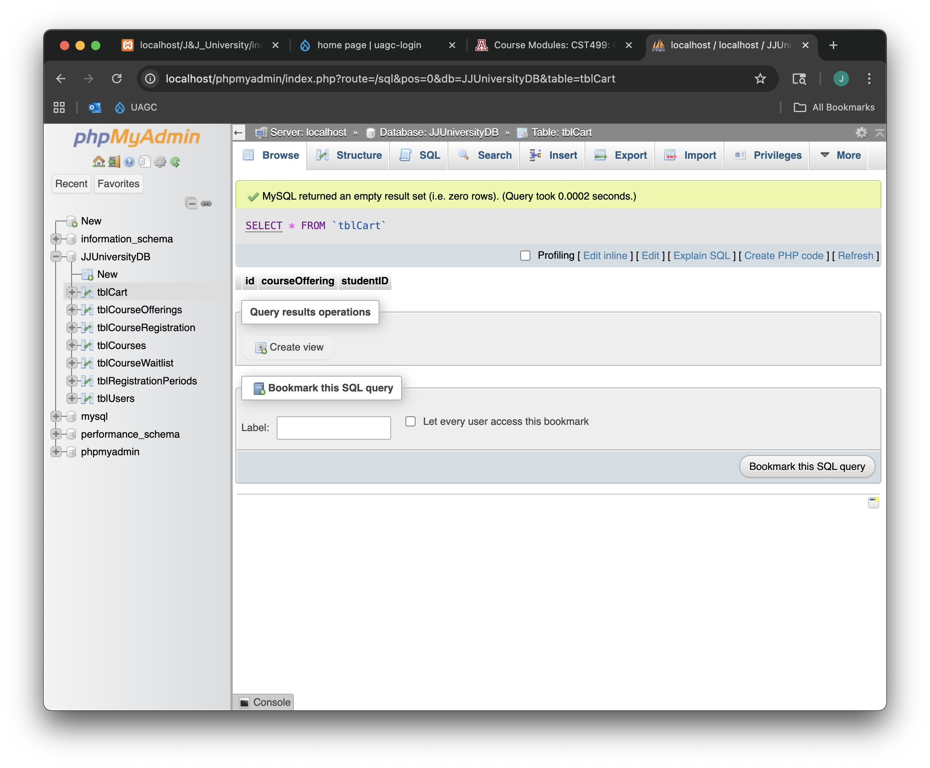
Course Management
Databases

Slide 25
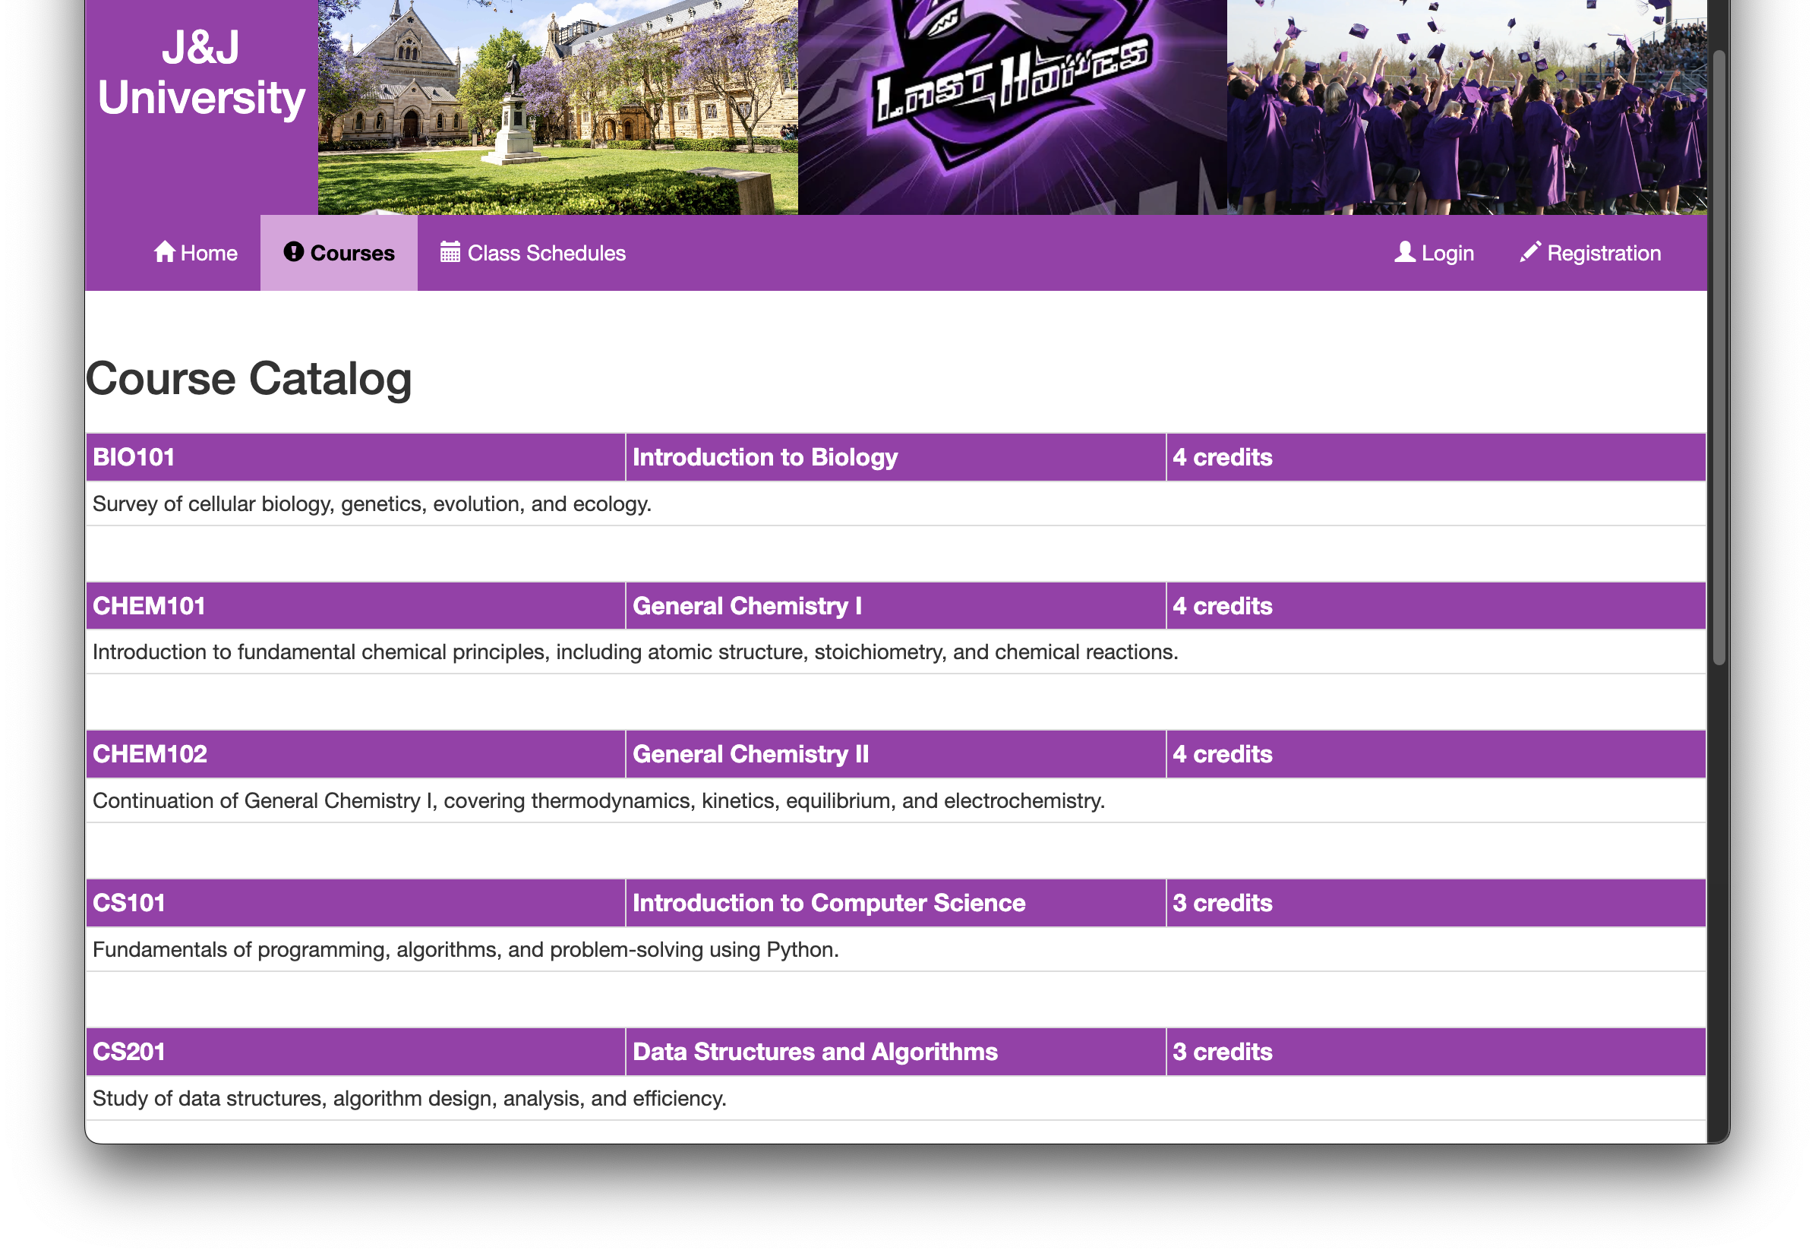
Course Management
Catalog

Slide 26
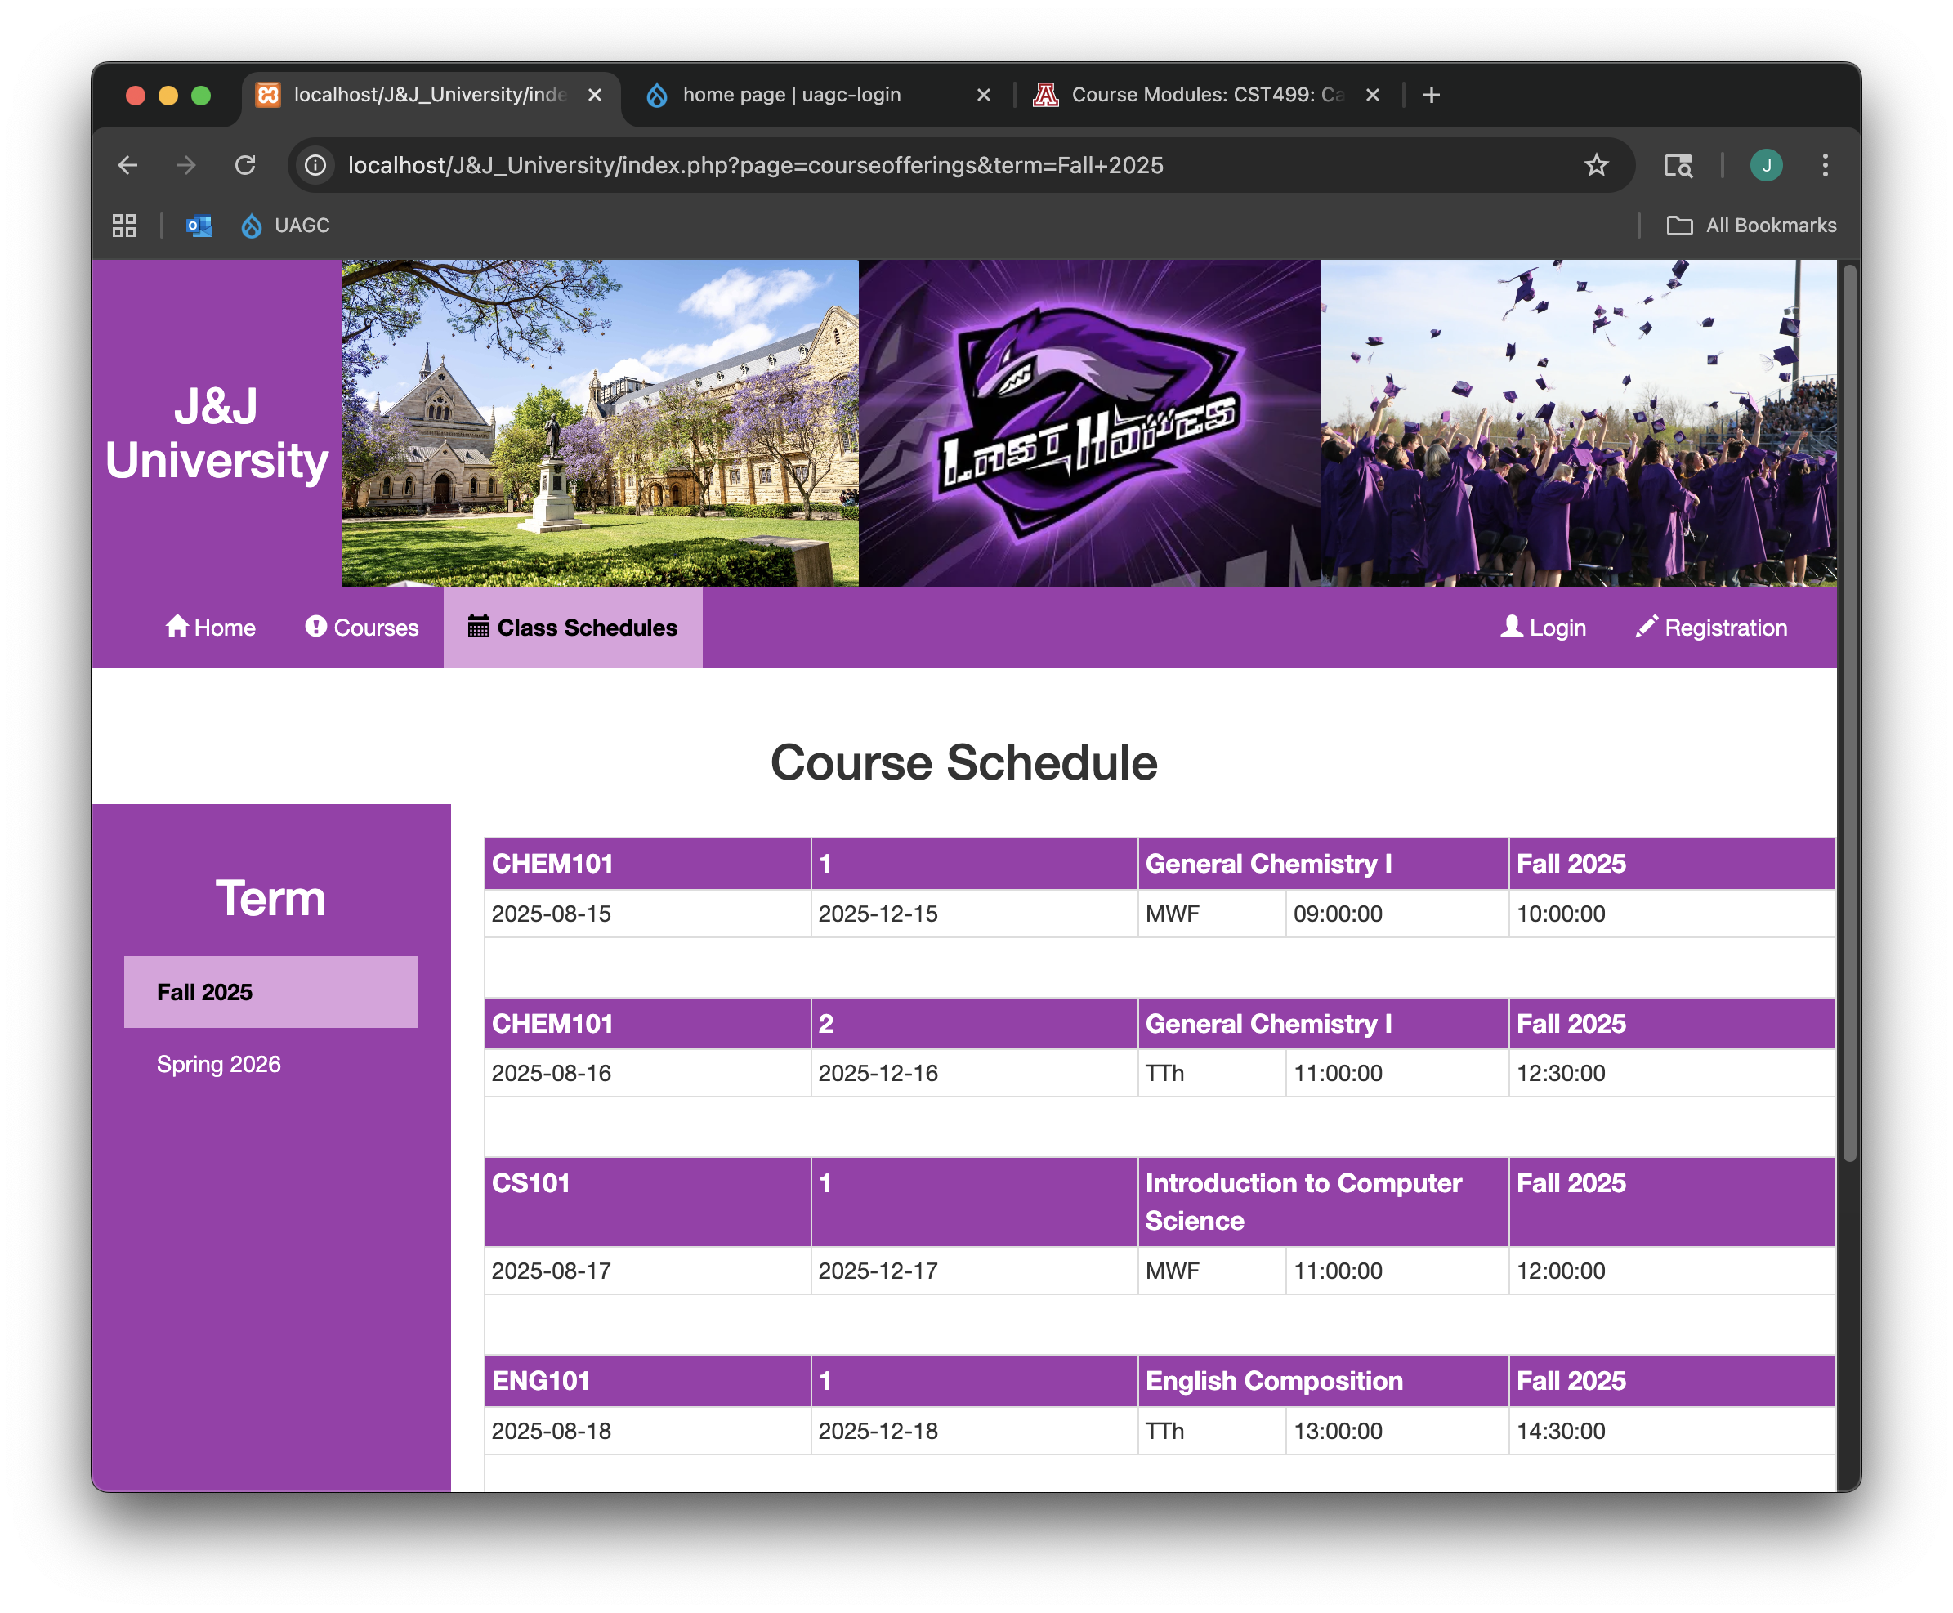
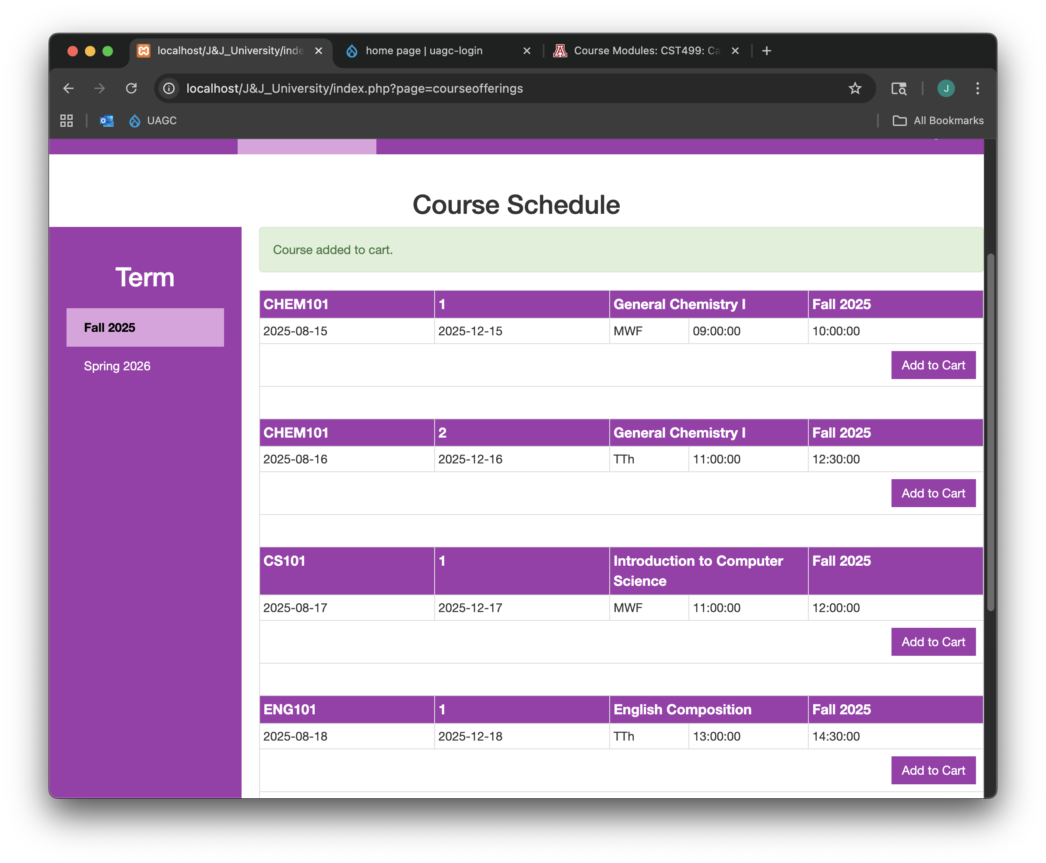
Course Management
Course Offerings

Slide 27
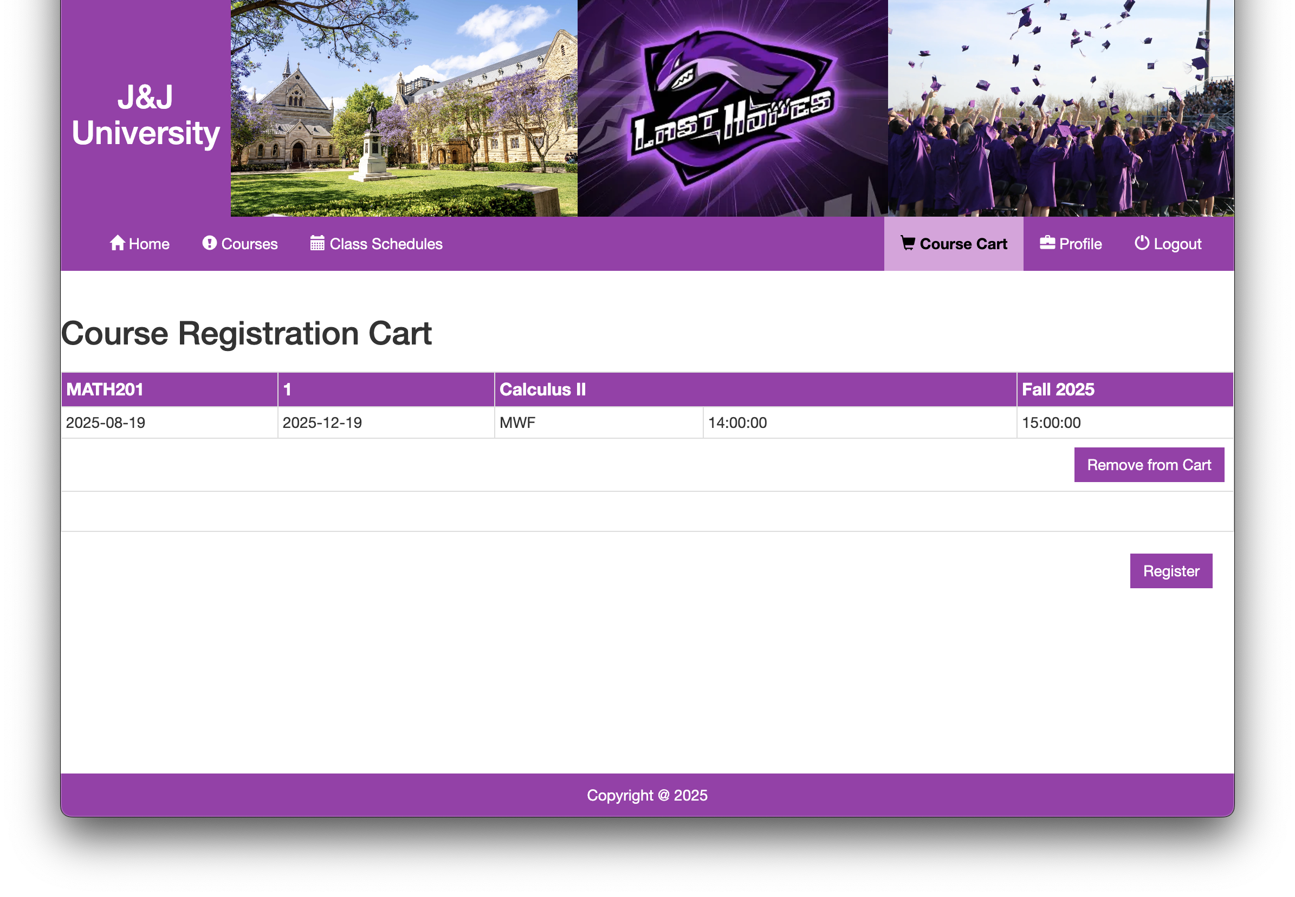
Course Management
Cart

Slide 28
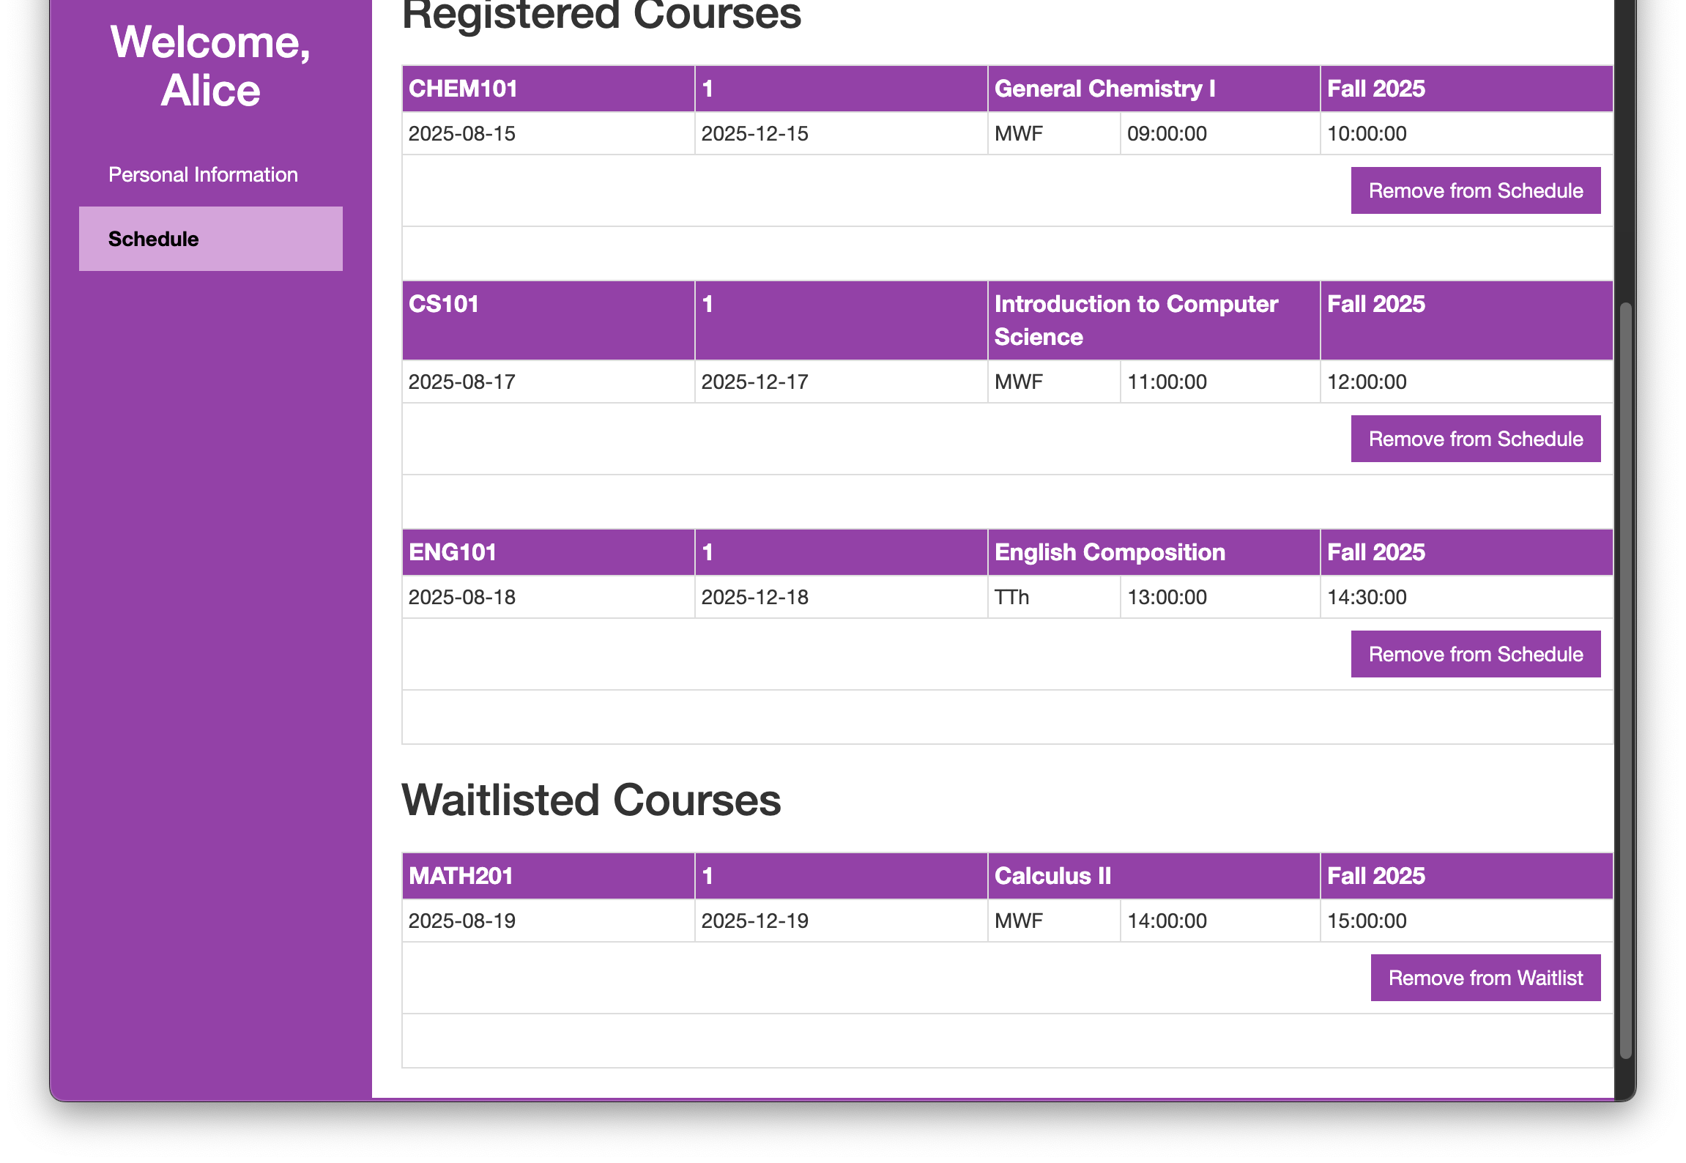
Course Management
Registered/Waitlisted Courses

Slide 29
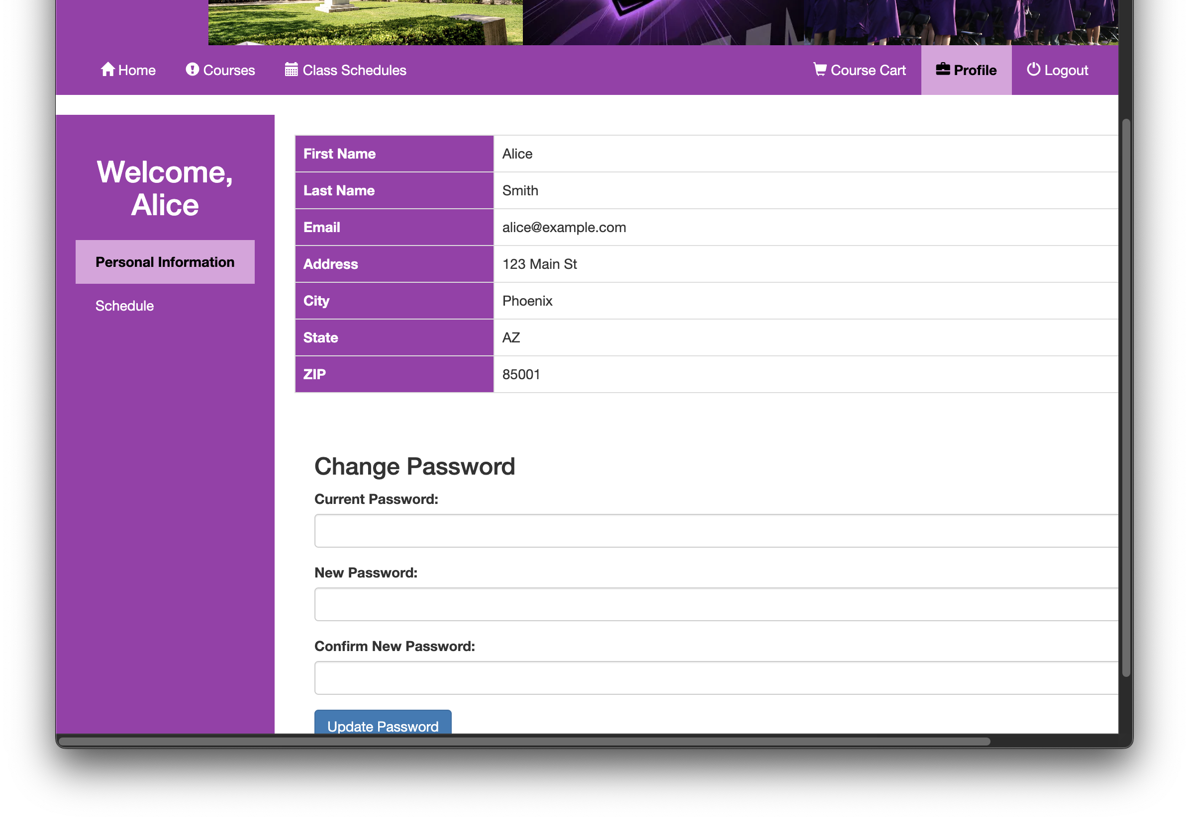
Profile Management

Slide 30
Deviation from Requirements
No longer able to create courses or course offerings in this system

Slide 31
Suggested Improvements
Add prerequisites to the courses and course offerings
Add verification of prerequisites to course registration
Add verification of scheduling conflicts to course registration
Add confirmation step for button presses (i.e. Register, Unregister, Remove from Waitlist, and Logout)

